Slide 1

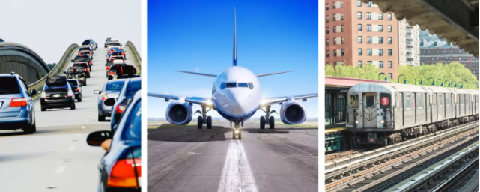

Which is the Safest Mode of Travel?
Project Task-5
Prashant Raghuwanshi
DSC, Bellevue University
DSC640-T301 Data Presentation & Visualization (2223-1)
Professor Catie Williams
3/04/2022

Slide 2
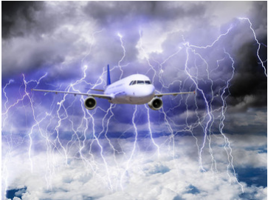


Recent Media Reports Shows Air Travel is No Longer Safer
Did Data Supports Media’s Theory ???

Slide 3
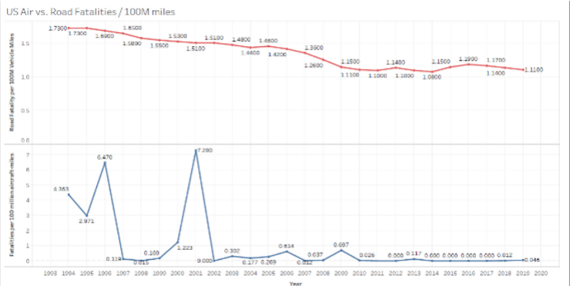
in 2020 we have approx. 1.11 ground fatality VS 0.04 Air fatality per 100 Million travel miles.
Air vs Ground Fatalities in Last 30 Years

Slide 4
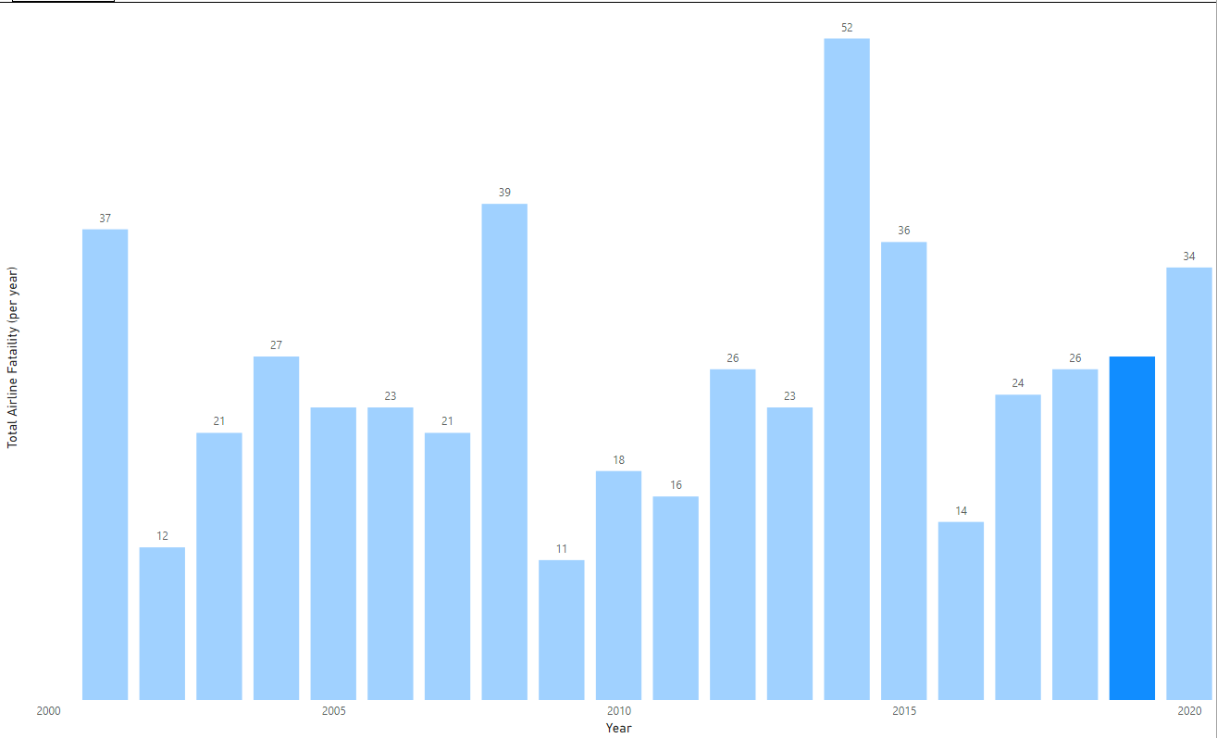
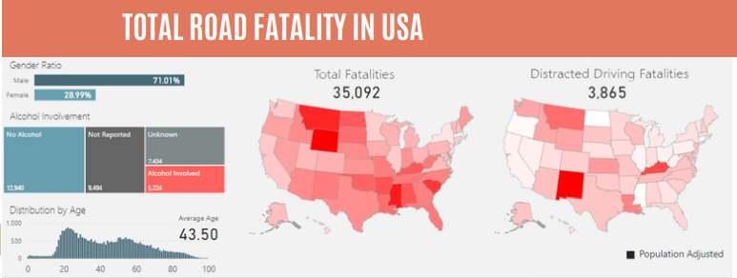
Which is Huge?
Total Air Fatality in 2019 is 24
Vs
Total Road Fatality in the USA is 35092

Slide 5
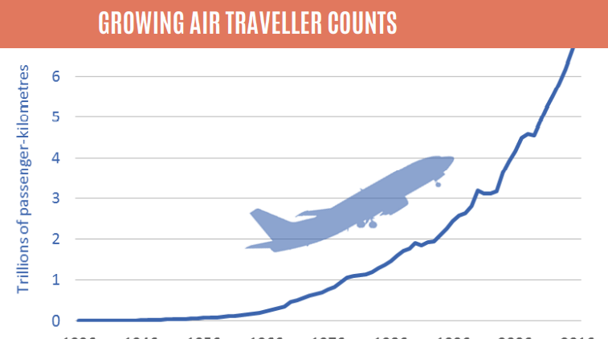
Airline is The Most Trusted & Safest Mode of Travel

Slide 6
References
Used Datasets list in Dashboard:
Accidents and fatalities per year
https://docs.google.com/spreadsheets/d/1SDp7p1y6m7N5xD5_fpOkYOrJvd68V7iy6etXy2cetb8/edit#gid=1448957446
Summary 2017-21
https://docs.google.com/spreadsheets/d/1SDp7p1y6m7N5xD5_fpOkYOrJvd68V7iy6etXy2cetb8/edit#gid=1733053069
Vehical_accident_2019.CSV
https://www.nhtsa.gov/data
airline revenue - supplemental dataset
Power BI web scraping :
http://web.mit.edu/airlinedata/www/2020%2012%20Month%20Documents/Traffic%20and%20Capacity/System%20Total/Passenger%20Revenue%20--%20Total%20System%20Operations.htm")
Economic Impact of Commercial Aviation By State, Airlines for America
https://www.nhtsa.gov/data
https://www.fitchratings.com/research/corporate-finance/global-air-traffic-recovery-will-continue-in-2022-but-risk-remains-30-11-2021
airline_op_cost - supplemental dataset
Power BI web scraping :
https://www.airlines.org/dataset/a4a-quarterly-passenger-airline-cost-index-u-s-passenger-airlines/
https://www.airlines.org/impact/

Slide 7
Thank You !!

